Slide 1
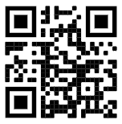
TopHat activities
Please join and indicate that you have done so:
https://app.tophat.com/login Join: 147651

Slide 2

Functional Requirements
CO1106 Requirements Engineering and Professional Practice
Dr Matthias Heintz
(mmh21@leicester.ac.uk)

Slide 3
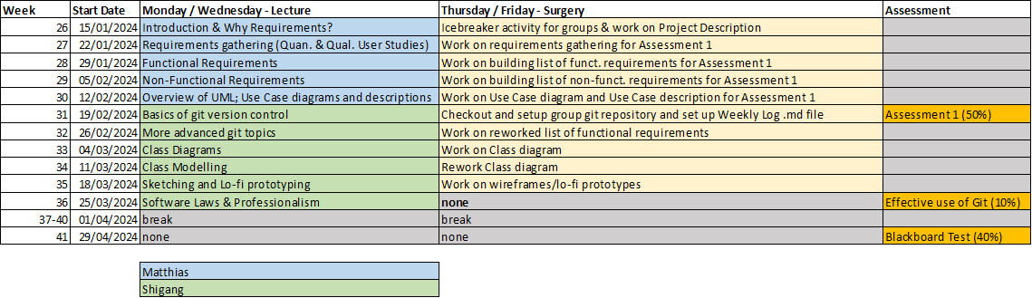
Schedule

Slide 4
Session objectives
At the end of the lecture you will:
Explain what a requirements specification document is
List the things you would include and not include in one
Distinguish different types of requirements
Describe what a good user story is
Derive system requirements from user stories

Slide 5

Group coursework in CO1106
Main group project
Part 1 (50% - due 23rd February)
Project description (10%)
Quantitative and qualitative studies (10%)
Written requirements (20%)
Use Case UML Diagram and Use Case Description (10%)
Part 2 (10% - due 27th March)
Effective usage of git version control

Slide 6
Group Coursework Part 1 - Task 3 Written requirements (20% of module marks)
Overview
You must produce between 1 and 2 pages of written requirements [functional (10%) and non-functional (10%) requirements] that describe, in detail, one or more of the key distinct features of your application (i.e. for example not the login process, but functionality that is specific for your project).

Slide 7
Instructions
Functional requirements
Based on your project description and data collection / analysis results:
Think about which features are needed (User Stories can help here)
Write must have / should have / could have functional requirements covering those features
Focus on features specific to your project (e.g. login, password reset and other common functionality is less important)
Notes:
Try to avoid group think, come up with 4 or 5 yourself, before taking them to the group

Slide 8
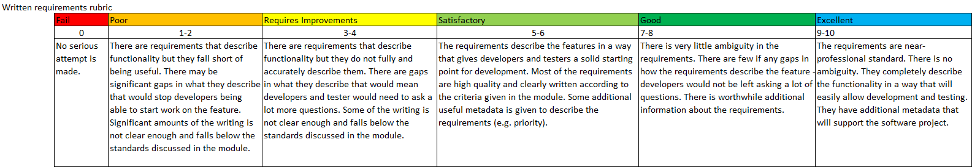
Marking rubric
Notes:
for completeness: Please read in your own time and ask any questions during the next lecture or during surgeries

Slide 9
Requirements Specification

Slide 10

Reminder
This is a module about writing requirements
Requirements describe software
They are used and updated by everyone on a software project
They are critical to a project success.

Slide 11

Requirements engineering
The process of establishing the services that the customer requires from a system and the constraints under which it operates and is developed.
The requirements themselves are the descriptions of the system services and constraints that are generated during the requirements engineering process.
Notes:
Documented artifact of the process, note that the term requirement is not used consistently, different levels..

Slide 12

Example of some requirements
“A text box allows users to enter search terms"
"Users can click the "Search" button to submit their search”
"Users are shown a list of web pages that contain the search term(s) that they entered”
"The pages are sorted in order of relevance, with the most relevant at the top”
"For each web page the user is shown the title of the page, the url, and a 150-character excerpt from the page "
Notes:
What is described here?

Slide 13

Requirements specification
Describes the whole system
Is made up of many tiny requirements
It's the single, shared, agreed description for everyone.
This is what you are creating for your group project

Slide 14
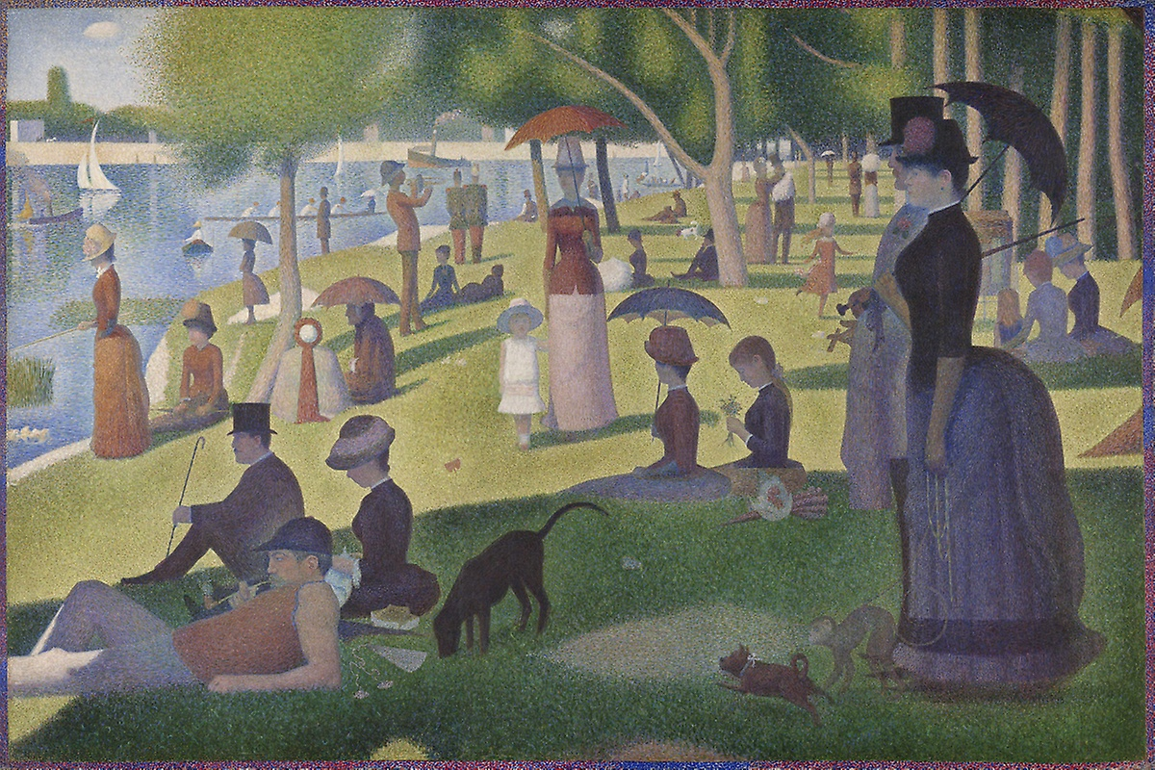
A Sunday Afternoon on the Island of La Grande Jatte, Georges Seurat, 1884

Slide 15

What is this?
From Seurat's Parade de cirque, 1889

Slide 16
The overall picture describes the scene
It is made up of tiny dots
Each dot is perfectly formed and placed to add the needed detail to the picture
Each requirement is a tiny dot. They come together to form the complete picture

Slide 17
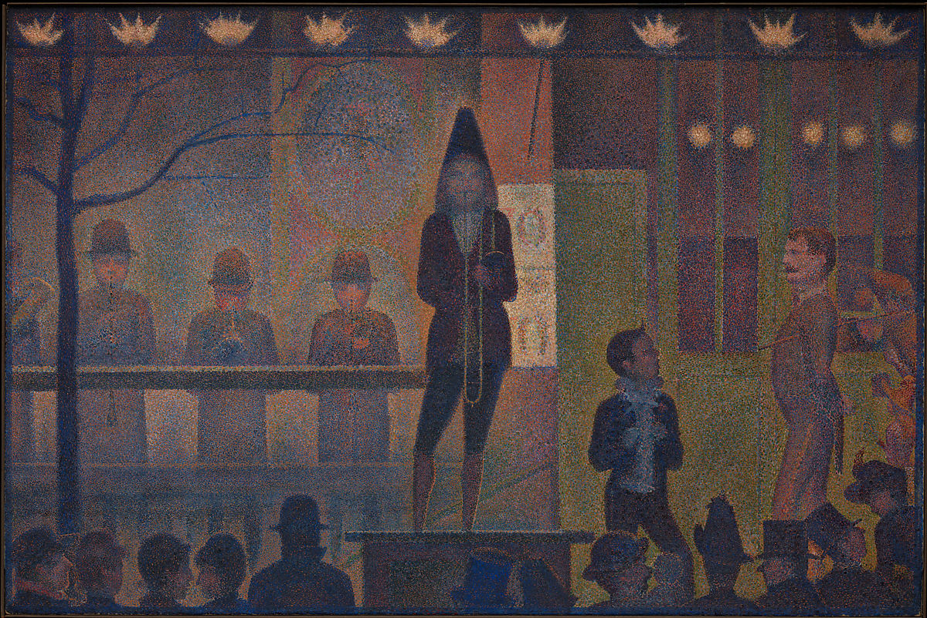
Parade de cirque, Georges Seurat, 1889

Slide 18
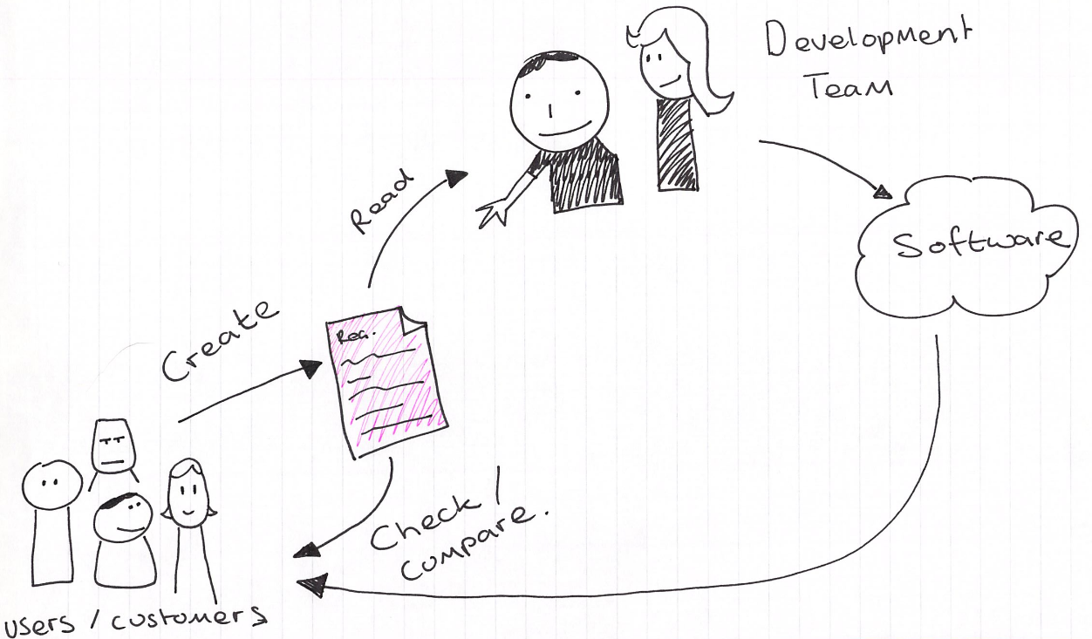
Requirements specification
Documenting the understanding of people’s needs
The “instructions” to the development team
The “acceptance criteria” for the final software/system
Into a document called Requirements Specification (one or more)
Shared, agreed description for everyone

Slide 19
The requirements specification document
The software requirements document is the official statement of what is required of the system developers.
Can include both a definition of user requirements and a specification of the system requirements.
It is NOT a design document. As far as possible, it should set out WHAT the system should do rather than HOW it should do it.

Slide 20
Things useful to have in a requirement specification
Written requirements
Models
Sections and subsections for organisation
Table of contents
Definitions of terms
History of the document (e.g. who wrote, updated)

Slide 21
Requirements completeness and consistency
In principle, requirements should be both complete and consistent
Complete
They should include descriptions of all facilities required
Consistent
There should be no conflicts or contradictions in the descriptions of the system facilities
In practice, it is impossible to produce a complete and consistent requirements document

Slide 22
Types of Requirements

Slide 23
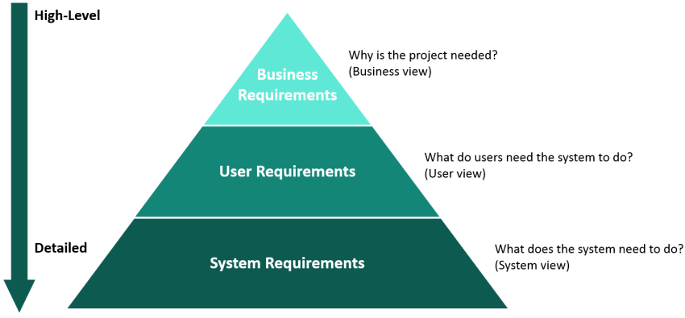
Requirements hierarchy

Slide 24
Types of requirement
User requirements
Statements in natural language plus diagrams of the services the system provides and its operational constraints. Written for customers.
System requirements
A structured document setting out detailed descriptions of the system’s functions, services and operational constraints. Defines what should be implemented so may be part of a contract between client and contractor.
Notes:
e.g. control device, place order, find information.

Slide 25
User vs. system requirements
User requirements:
End-users will NOT be concerned with the detail
Generic, abstracted written requirement
The user is the main subject
System requirements:
Target the stakeholders involved in the development
Have to be precise without providing too many details on the implementation
Exactly what the system should do -> system is the main subject

Slide 26


User vs. system requirements
The user should get monthly management reports showing the cost of drugs prescribed by each clinic during that month.
The system shall automatically generate the report for printing after 17:30 on the last working day of the month.

Slide 27
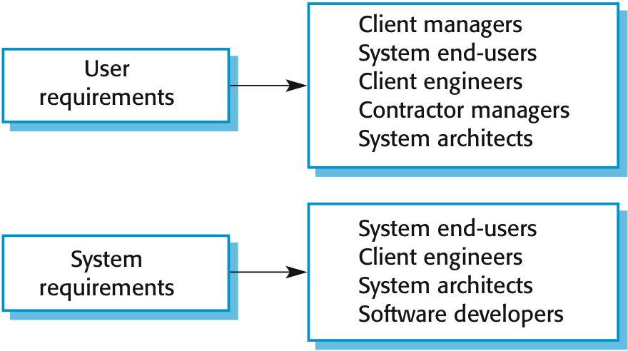
Readers of different types of requirements specification
Notes:
Note that these are all different stakeholders.

Slide 28
Functional and non-functional requirements
Functional requirements
Statements of services the system should provide, how the system should react to particular inputs and how the system should behave in particular situations.
May state what the system should not do.
Non-functional requirements
Constraints on the services or functions offered by the system such as timing constraints, constraints on the development process, standards, etc.
Often apply to the system as a whole rather than individual features or services.
Notes:
A functional requirement specifies something that a user needs to perform their work (e.g., visibility)
a system may be required to enter and print cost estimates
A non- functional requirement specify all the remaining requirements not covered by the functional requirements i.e., quality requirements
Accessibility, concurrency, performance efficiency, price, privacy, interoperability, usability, security, etc.

Slide 29
Functional requirements
(Most requirements are of this nature)
"What the system will do”
"A user can log into the system using their company email address and password”
"The current date will be highlighted”
"An administrator can specify that they have read a notification by sending an email”
When expressed as user requirement, they are usually described in an abstract way.
However, more specific functional system requirements describe the system functions
Inputs, processing; how it will react to a particular input, the expected output etc.
Notes:
Functional user requirements may be high-level statements of what the system should do.
Functional system requirements should describe the system services in detail.

Slide 30
User Stories
Notes:
How can you come up with requirements?

Slide 31
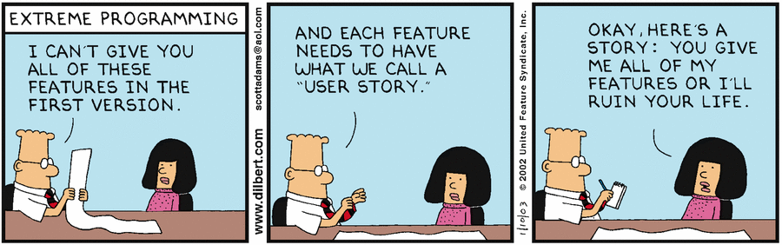
User Stories
Designed to be a lightweight form of user requirements documentation
much quicker to create
much easier to mark as complete
Written sequences of actions and events that lead to an outcome
Bridge the gap between users, designers and developers
Quick and easy way to get new requirements

Slide 32
User Stories
Often used in agile development
A one sentence statement of a clear requirement for a user
includes a role
includes a goal/desire/action
includes an effect/outcome
Good user stories
describe some specific need
short and testable

Slide 33

User stories
Take the form:
"As a <role>, I want <goal/desire> so that <benefit>"
E.g. “As a personal tutor, I want to easily schedule meetings with students so that I can get to know them better and discuss issues that they might have.”

Slide 34
How to write good user stories?
INVEST acronym:
I – Independent
N – Negotiable
V – Valuable
E – Estimable
S – Small
T – Testable
Notes:
Source for slides on INVEST:
https://xp123.com/articles/invest-in-good-stories-and-smart-tasks/

Slide 35
INVEST
Independent
Good user stories should
not overlap in concept
be independent of other stories
be able to be implemented in any order

Slide 36
INVEST
Negotiable
Good user stories
are not an explicit contract for features
capture the essence, not the details
(details) will be co-created by customer and programmer
may be enhanced through notes, test ideas, etc. over time

Slide 37
INVEST
Valuable
Good user stories
need to be valuable to the customer (e.g. no story that focusses just on improving the database layer with no presentation layer)

Slide 38
INVEST
Estimable
Good user stories
can be estimated

Slide 39
INVEST
Small
Good user stories
tend to be small
typically represent at most a few person-weeks of work
have small descriptions

Slide 40
INVEST
Testable
Good user stories
are testable
Notes:
When you write the story you should know how to test it.

Slide 41
Example

Slide 42

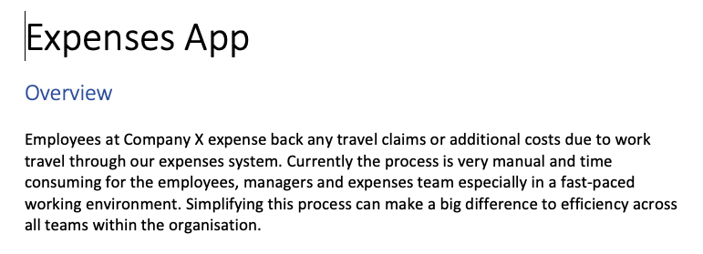
Example: User stories (expenses)

Slide 43
Example: User stories (expenses)
As an employee I want to login so that I can claim my expenses or see my previous claims
As a claimant I want to add a new expense claim so that I can be reimbursed for expenses
As a claimant I want to view a record of my previous expense claims so that I can check that I have been reimbursed correctly
As a claimant I want to return to partially completed expense claims so that I don’t have to complete the form in a single sitting

Slide 44
From User Story to Functional Requirements
Think about
acceptance criteria for the user story
what the system has to do to make this story possible
Notes:
User stories are not requirements!
But they can help you as a starting point to think about and generate your requirements.

Slide 45
From User Stories to Functional Requirements (User Requirements & System Requirements)
e.g.: “As a claimant I want to add a new expense claim so that I can be reimbursed for expenses.”
Can I save a draft of my claim and come back later to complete it?
=> “The user could safe their progress when adding an expense claim.”
Can I check the claim before submitting it?
=> “The system must show the claim for checking, before submitting it.”
Can I see the total claim amount based on what I have entered so far?
=> “The system should calculate and display the total claim amount.”
Can I add a claim at any time (24/7)?
Notes:
The last point is an example for a non-functional requirement, to be discussed in more detail next week.

Slide 46
Prioritisation of Requirements
Must have
critical / essential
e.g. “The system must show the claim for checking, before submitting it.”
Should have
important, but not necessary
e.g. “The system should calculate and display the total claim amount.”
Could have
nice to have
e.g. “The user could safe their progress when adding an expense claim.”

Slide 47

What’s next?
Based on the results of your quantitative and / or qualitative user studies you should now generate functional requirements for your group project
Receive feedback on your progress during the surgeries
Lecture next week: Writing Non-Functional Requirements

Slide 48
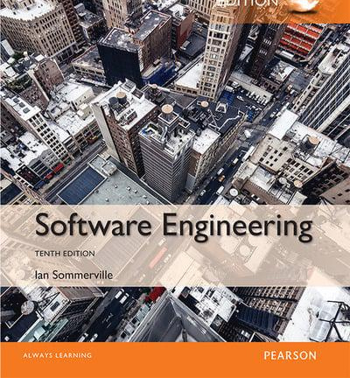
Additional reading
Ian Sommerville, Software Engineering
Chapter 4 Requirements Engineering

Slide 49

Questions?
Dr. Matthias Heintz
mmh21@leicester.ac.uk
Microsoft Teams
Office 613 in Ken Edwards Building

